Slide 1
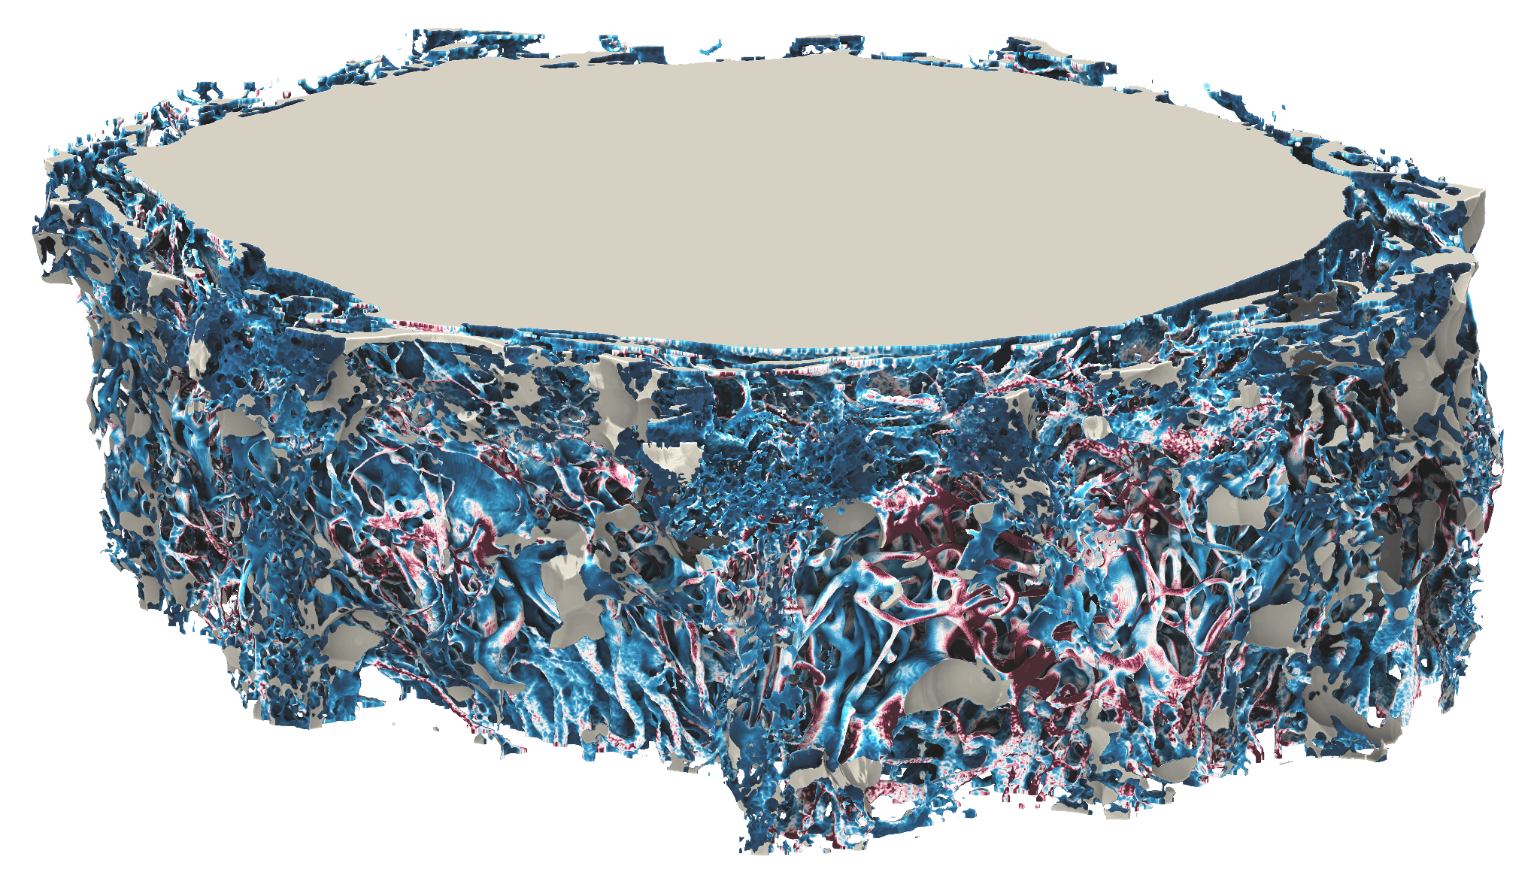
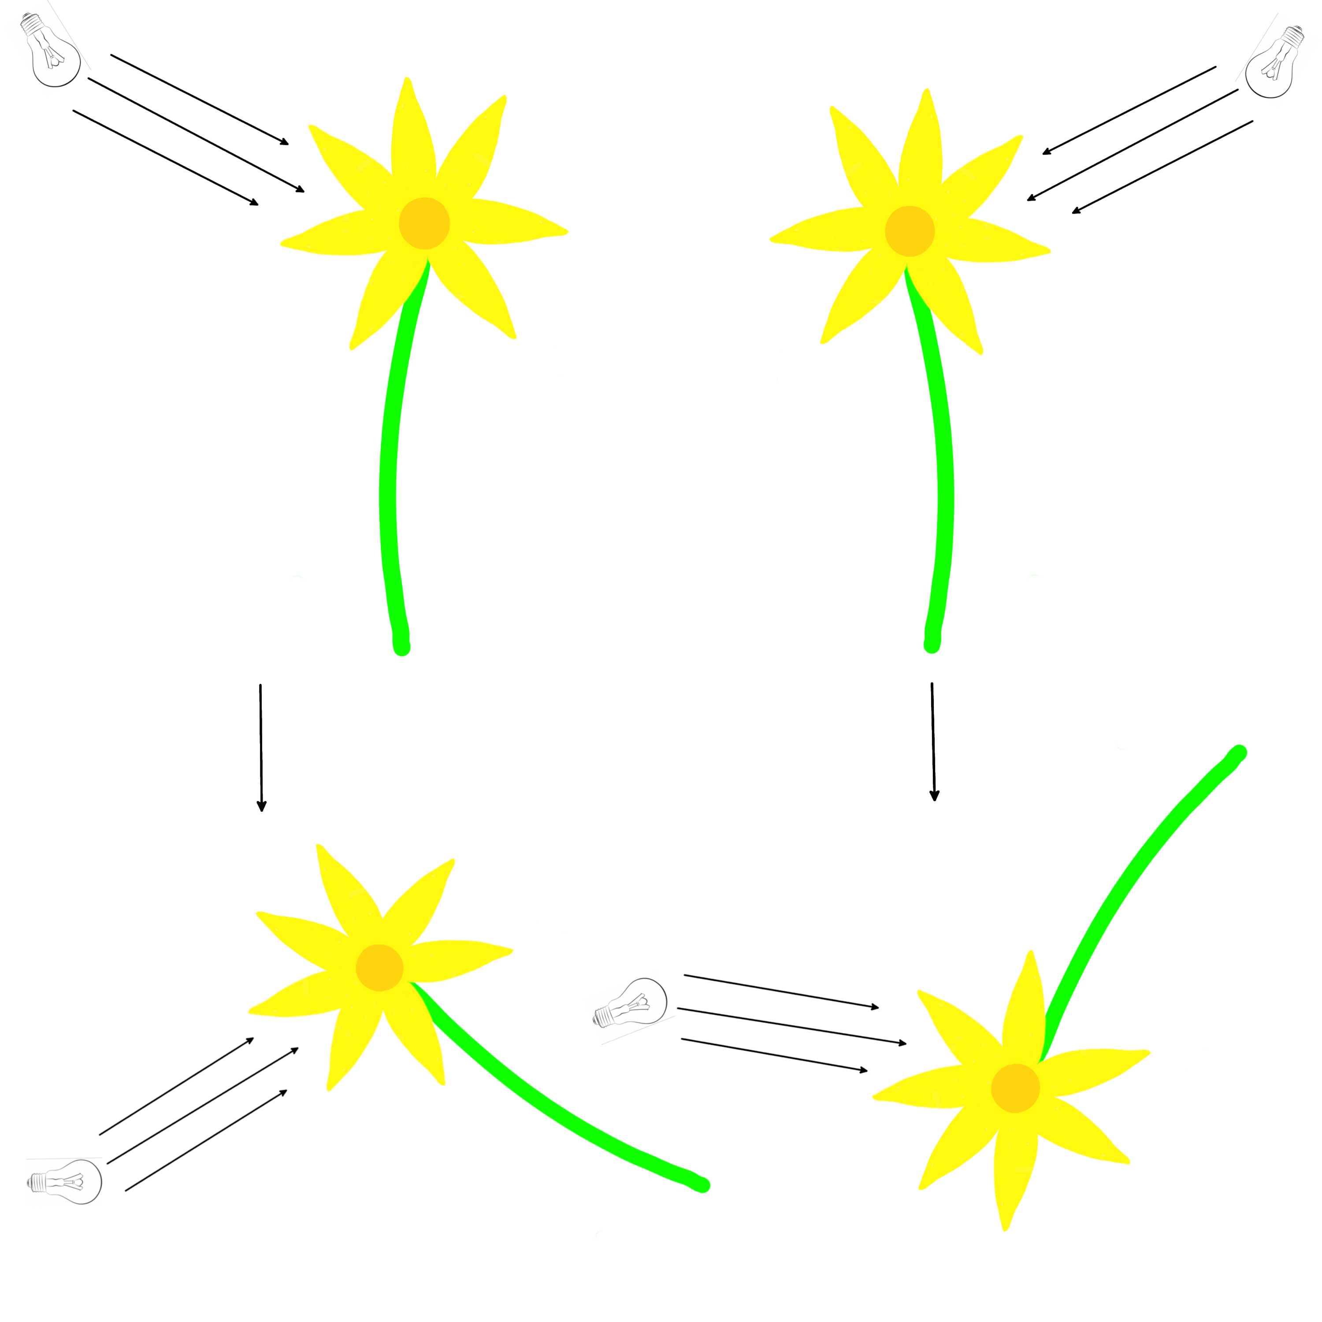
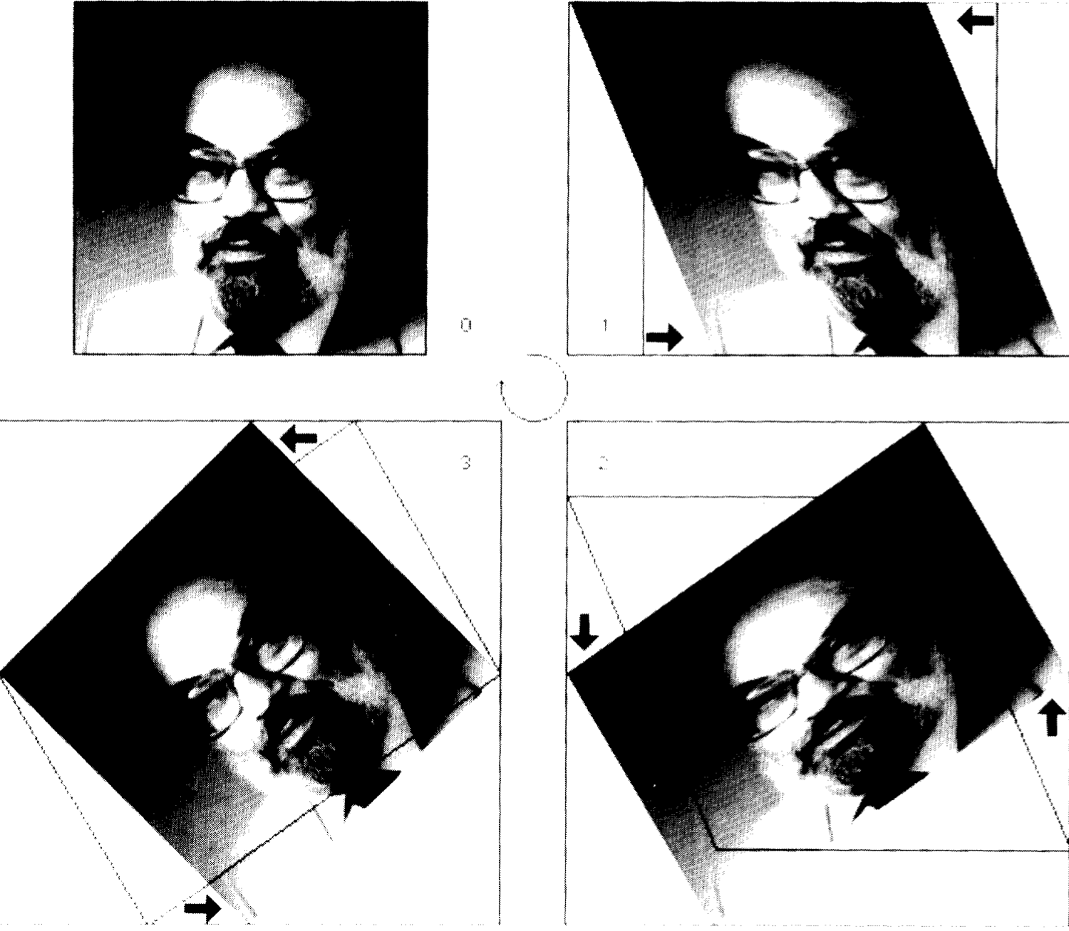
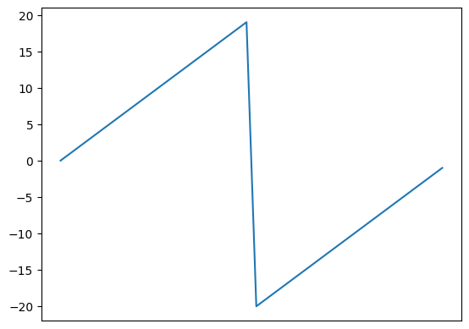
Rotation of multidimensional signals with spectral schemes
Student: Dylan Reid Ramelli
Advisor: Prof Rolf Krause
Co-Advisors: Dr Diego Rossinelli,
Dr Patrick Zulian
3D section of a blood vessel from the heart, Diego Rossinelli.
Light transport of high amounts of data
3D Perception vs. Slice.
Light attenuation.
Rotation of 3D signal with high performance methods.
Three 1D translations of data
1D f(x−h) f(xi)
f ≈ ∑i φi ci → Ax=b
How to design a high order scheme but local?
Three-pass rotation, Michael Unser
Frequency analysis
Digital Filter Design / FIR
Property of DFT → Shift equivariance
Fractional Shift
Smoothing

